Slide 1
SOAZ COACH ZONE
For HOD’s

Slide 2
Information
Access to Coach Zone
Inviting members
Checking status of members
Creating Sub-teams

Slide 3
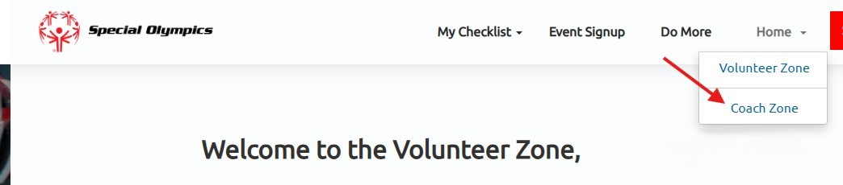
Accessing your Coach Zone
  Visit portals.specialolympics.org
  This will bring you to your volunteer zone
  If you click on the home drop down, you will see your
  Coach Zone. If you don’t see this let me know and I will give you access.

Slide 4
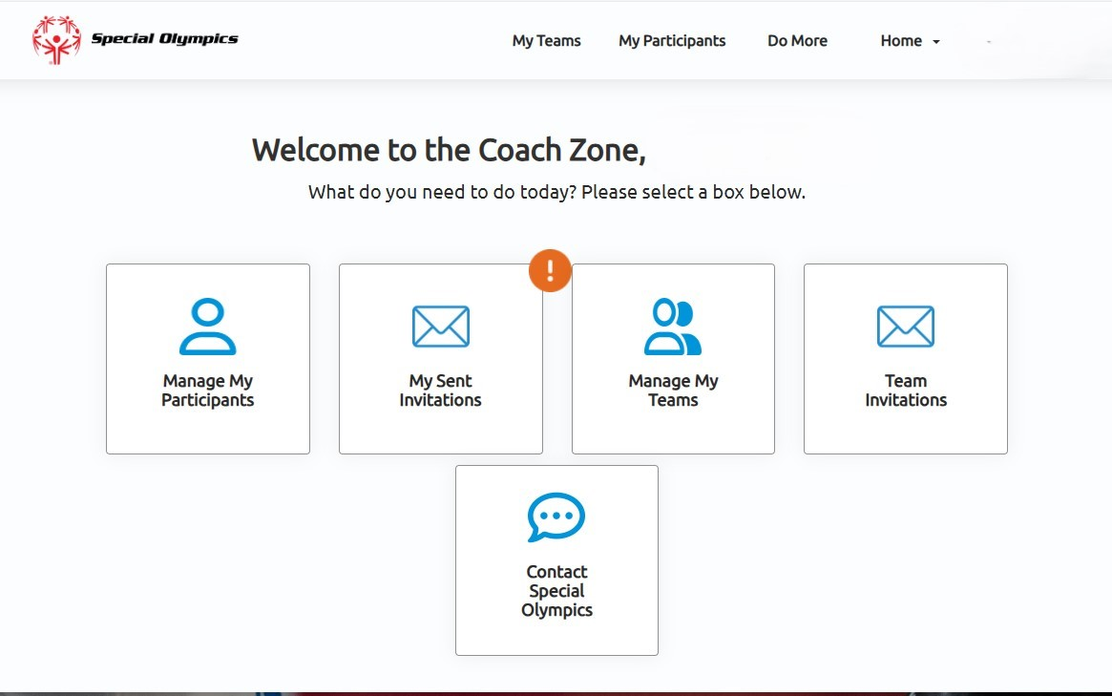
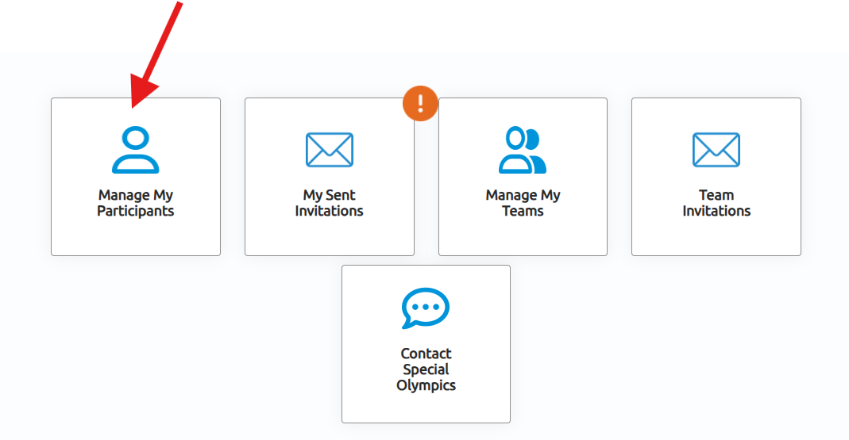
Now you’re in your Coach Zone.
Let’s Manage My Participants!

Slide 5
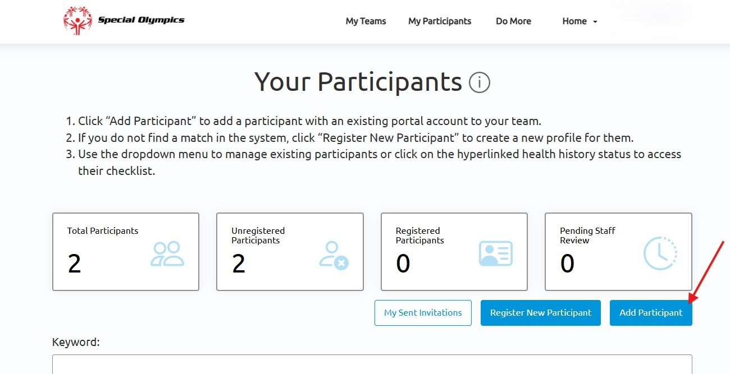
If you sent in your returning coaches, I’m working on adding your coaches to your groups. If you can’t find your delegation, please let me know .
You can also add your participants.
In the pop-up you will
need to select the team,
which is your delegation,
and the invitee. Use the
magnifying glass to see
these. The lookup records pop up you can search
by either first or last name.

Slide 6
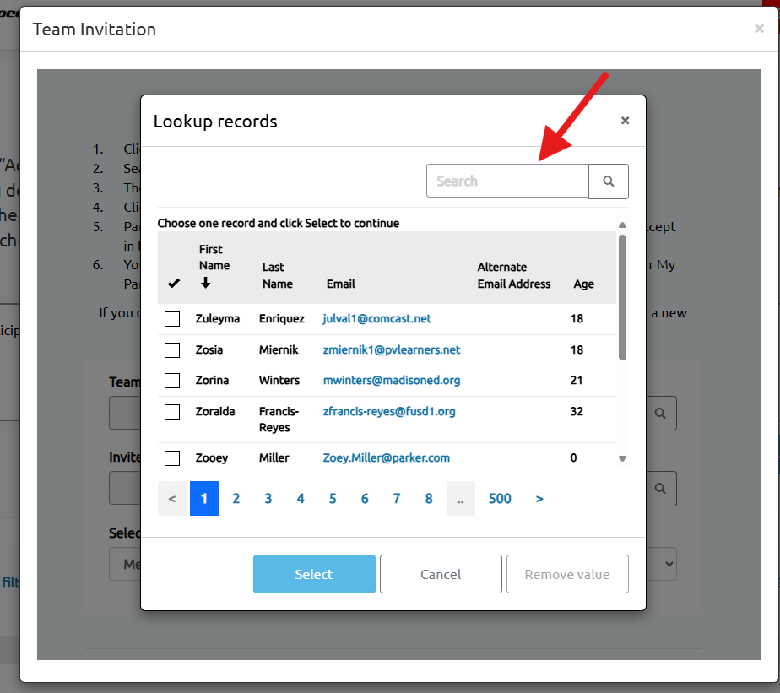
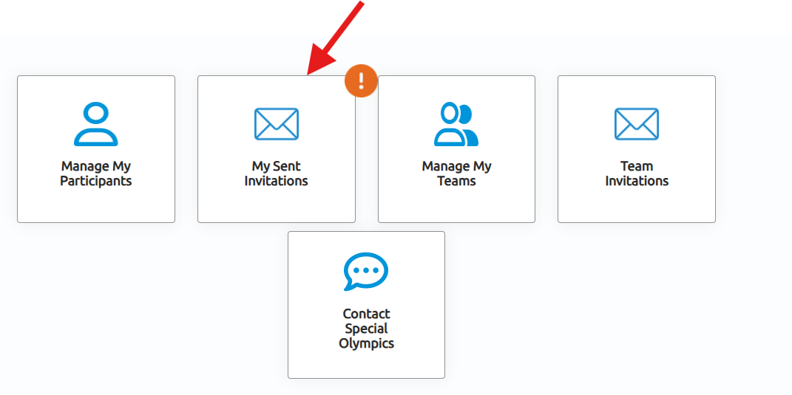
Once you’ve found your member,
  Hit hit select and choose the role for this participant and submit. This participant won’t show up under your team until they accept the invitation to join. You can check the status of your invites by selecting “My Sent Invitations”. You will see the exclamation mark if you have unanswered invites.
  If for any reason they don’t respond and you need them added please contact
  me and I can do that
  for you.

Slide 7
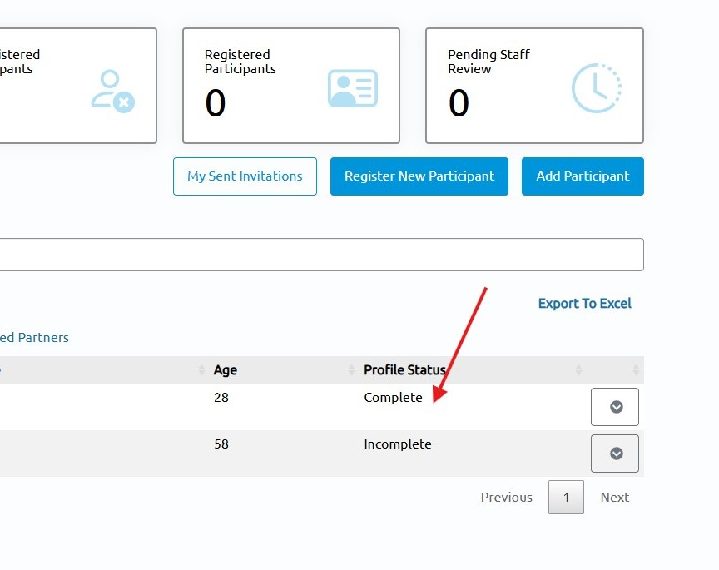
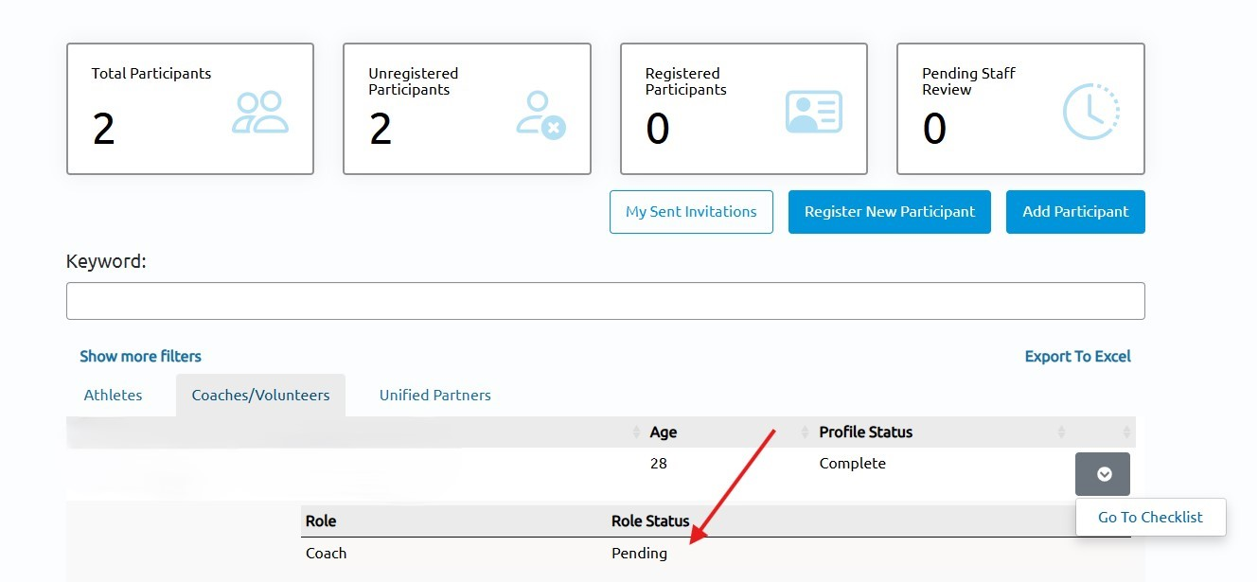
Now that you have added your participants, let’s see how to check if they have completed all certifications.
Go to manage my participants and choose
Coach/Volunteers or Unified Partners.
This will show their profile status,
which tells you if they have connected
to their portal account and completed
the profile questions. To see their
role status you will need to click the carrot at the end.

Slide 8
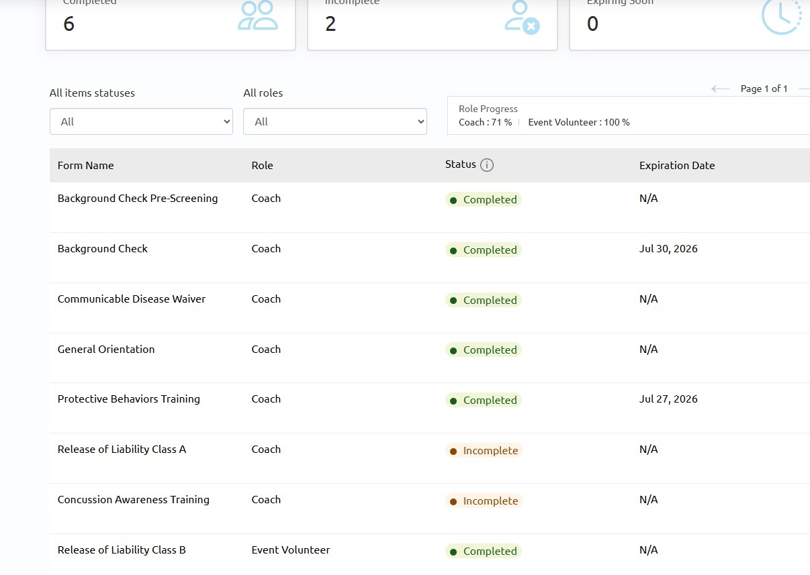
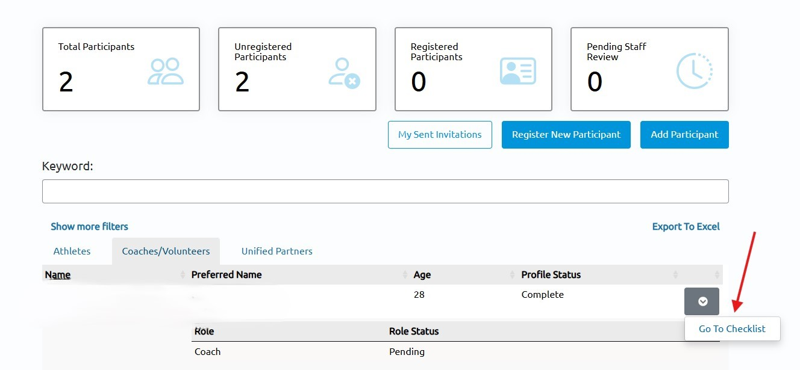
It will either show active or pending. If it says pending, you can then click on “Go To Checklist”
This is where you will be able to see exactly what your participant is missing. You can not change anything it is read only.

Slide 9
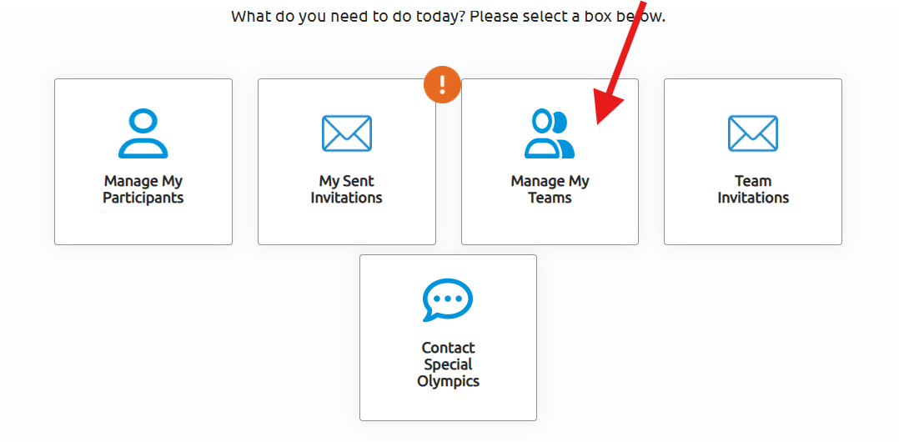
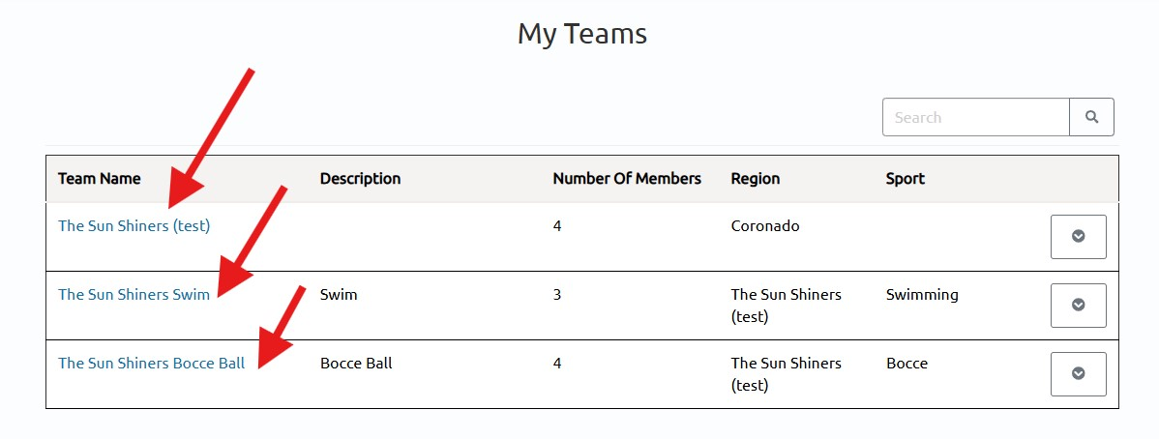
Let’s create a sub-team. You would do this if your delegation participates in multiple sports.
Go to “Manage My
Teams”. The Sun
Shiners are the Main
Delegation.

Slide 10
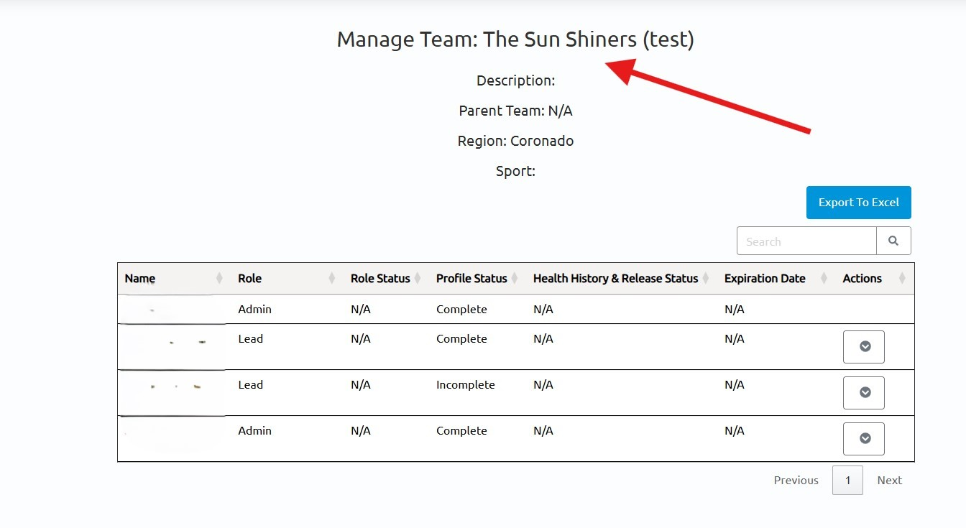
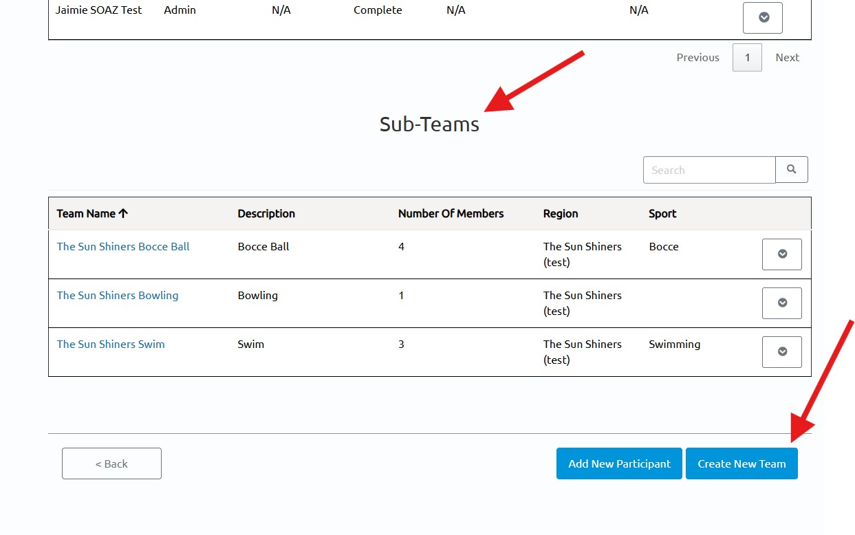
You will click on the carrot next to your Main Delegation. Below the main delegation you will see Sub-Teams and below that Create New Team.

Slide 11
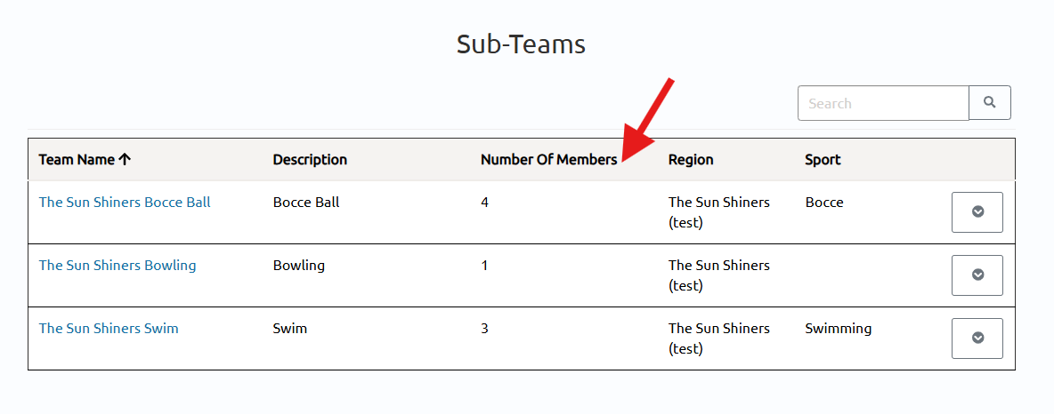
When you create the sub-team all participants will load into that team. You can then go in and delete the participants who are not on that team.
You do this by clicking on the team. This will show all
Participants. To delete click on the carrot next to the
Name you wish to delete from that team.

Slide 12
General Notes
My information
Sheila Sevinsky sports@specialolympicsarizona.org
(602) 476-0842
Please remember this is a new system and there will be issues. Be patient! When all the bugs are worked out it will be AMAZING!!
We will be adding athletes near the end of the season in
2026. There will be an additional training when we bring
them on.

Slide 13
Thank you

